Slide 1
主題図
Thematic maps

Slide 2
素朴な分布図 Mississippi River: Significant flood outlook areas where significant flooding is occuriring or imminent, May 22-27, 2011.
Notes:
https://www.census.gov/geo/maps-data/maps/ms_flood_may11.html

Slide 3
Choropleth map = 階級区分図
Notes:
http://slideplayer.com/slide/9409906/28/images/2/Choropleth+Map.jpg

Slide 4
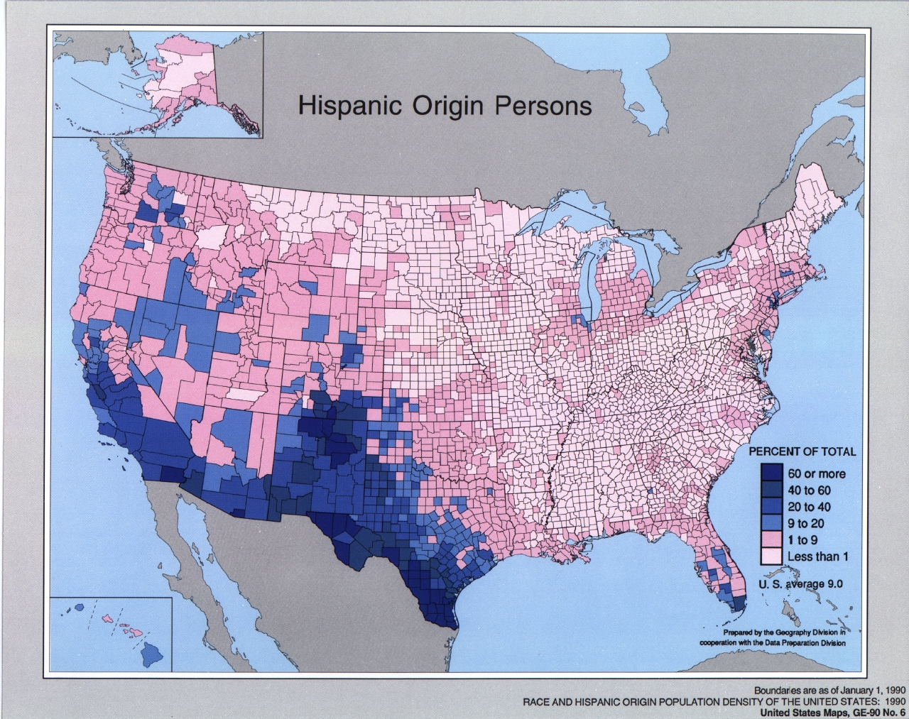
1990 Race and Hispanic Origin Population Density
Notes:
https://www.census.gov/geo/maps-data/maps/race-hisp1990.html

Slide 5
Incorrect (population, left) and correct (population density, right) application of a choropleth to data for Boston, Massachusetts
Notes:
https://en.wikipedia.org/wiki/Choropleth_map

Slide 6
Dot distribution map: Hay 1 acre = 4047 m² , 10,000 acres=40 km² , county単位。
Notes:
http://slideplayer.com/slide/9409906/28/images/7/Dot+Maps.jpg

Slide 7
ドットマップの長所と短所
Advantage:
They highlight areas of high density at a glance You can map raw data They are easily understood They work well with all kinds of data
Disadvantages:
They can give the impression that some areas have nothing. Dot placement can be random (no phenomena where dot is placed). It can be hard to interpret when too many dots are close together. It's difficult to count large numbers of dots to find values.
Notes:
https://sites.google.com/site/piggraphy/home/cartographic-d/dot-maps

Slide 8
Isoline maps 等値線図
Notes:
https://sites.google.com/site/piggraphy/home/cartographic-d/isoline-maps

Slide 9
Cartogram 統計地図
Notes:
http://slideplayer.com/slide/9409906/28/images/23/Cartogram+Total+population.jpg

Slide 10
flow lines 流線図
Flow maps can indicate things like:
1. What it is that flows, moves, migrates, etc.
2. What direction the flow is moving and/or what the source and destination are.
3. How much is flowing, being transferred, transported, etc.
Notes:
https://sites.google.com/site/piggraphy/home/cartographic-d/flow-lines

Slide 11
Disire lines スパイダーダイアグラム
Notes:
http://desktop.arcgis.com/ja/arcmap/10.3/tools/business-analyst-toolbox/desire-lines.htm

Slide 12
Desire line スパイダーダイアグラム
Desire lines = a straight line on a map representing the movement of people and goods from region to region. Also shows strength of desire to move with lines of proportional thickness. They are very similar to flow lines except they group movement, showing movement only directly from A to B whilst flow lines follow the exact path of movement.
Notes:
https://sites.google.com/site/piggraphy/home/cartographic-d/desire-lines

Slide 13
Trip lines
simplest map for showing movement, shows journeys from a starting point to a central point
Notes:
https://sites.google.com/site/piggraphy/home/cartographic-d/trip-lines

Slide 14
これは？ Median Center of Population for the United States: 1880 to 2010
Notes:
https://www.census.gov/geo/reference/centersofpop.html

Slide 15
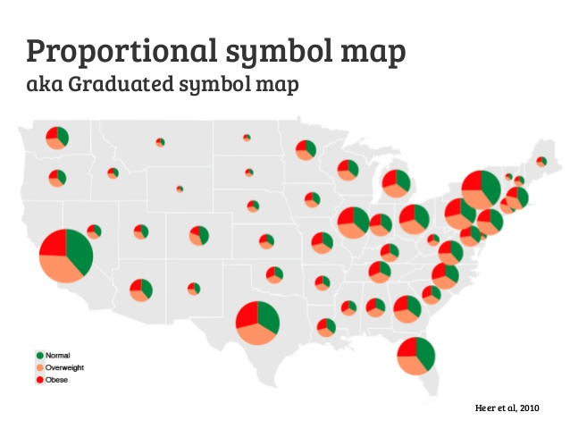
Proportional symbol map
This map shows the population in each country of the world in 2005 (source: UNdata)
Notes:
http://blog.mastermaps.com/2008/04/making-proportional-symbols-in-kml.html
https://www.google.co.jp/search?q=Located+Proportional+Symbols&tbm=isch&imgil=ak4OBChKp23qbM%253A%253B9i0XouCDQu5C4M%253Bhttps%25253A%25252F%25252Fmappingignorance.org%25252F2013%25252F12%25252F16%25252Fthe-complexity-of-drawing-good-proportional-symbol-maps%25252F&source=iu&pf=m&fir=ak4OBChKp23qbM%253A%252C9i0XouCDQu5C4M%252C_&usg=__pWwRTyXJXznHFSEsu93j121JubY%3D&biw=1078&bih=544&ved=0ahUKEwjMmNS457XUAhXEGpQKHTDlA2gQyjcINg&ei=hzk9WYy5I8S10ASwyo_ABg#imgrc=5pVeLgdsO4eFUM:

Slide 16
Graduated circle maps 図形表現図
Notes:
http://slideplayer.com/slide/9409906/28/images/12/Graduated+Circle+Map.jpg

Slide 17
Graduated and Proportional Symbol Maps
Graduated and proportional symbol maps are a class of maps that use the visual variable of size to represent differences in the magnitude of a discrete, abruptly changing phenomenon, e.g. counts of people. Like choropleth maps, you can create classed or unclassed versions of these maps. The classed ones are known as range-graded or graduated symbols, and the unclassed are called proportional symbols, where the area of the symbols are proportional to the values of the attribute being mapped.
Notes:
https://www.e-education.psu.edu/geog486/node/1869

